Slide 1

Data Analysis of Facebook marketplace dataset
Finlatics
February 20, 2025
Hitesh Choudhary

Slide 2


Agenda
Introduction
Information about data
Relation between time of upload and total number of reactions
Co-relation between reactions , comments and shares
Analysis of whole dataset
Conclusion

Slide 3

Introduction
The given dataset is continuous dataset which is the Facebook Live Sellers in Thailand dataset contains information about the Facebook pages of 10 Thai fashion and cosmetics retail sellers.

Slide 4

The dataset is in a tabular format. It shows information about reactions on specific date and time on different type of post such as photos , videos , links , status. It contains 7050 rows and 14 columns. Let’s see how this data is useful to understand the user’s behaviour.
Let’s dive in

Slide 5
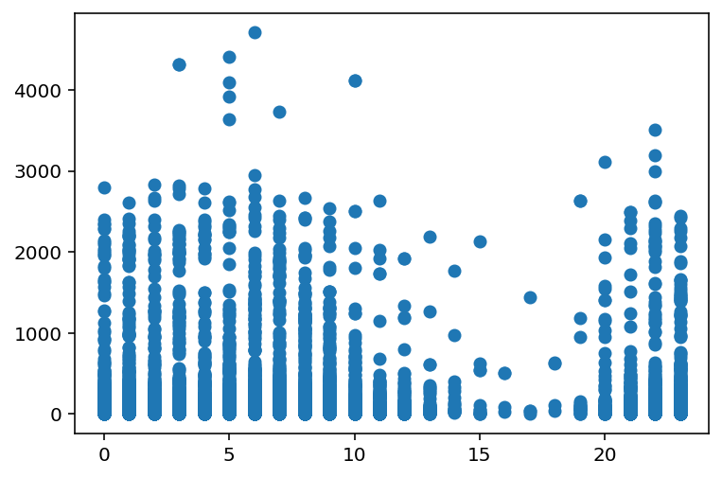
Relation between time of upload and total number of reactions
Scatter plot graph showing time in 24 hour format from 0 to 23 on x-axis
And on y axis total summation of number of reactions in that hour.
According to graph there are more reaction between from 23 in night to 6 in morning ,from this we can conclude that people are mostly active on Facebook in midnight and in morning as total number of reactions are high at those also people are less active from 10 to 20 which means people are busy than regular activities time in that time so this graph is helpful to analysis when is the best time to post the Thailand dishes photos,videos,link so that it can reach maximum audience.

Slide 6
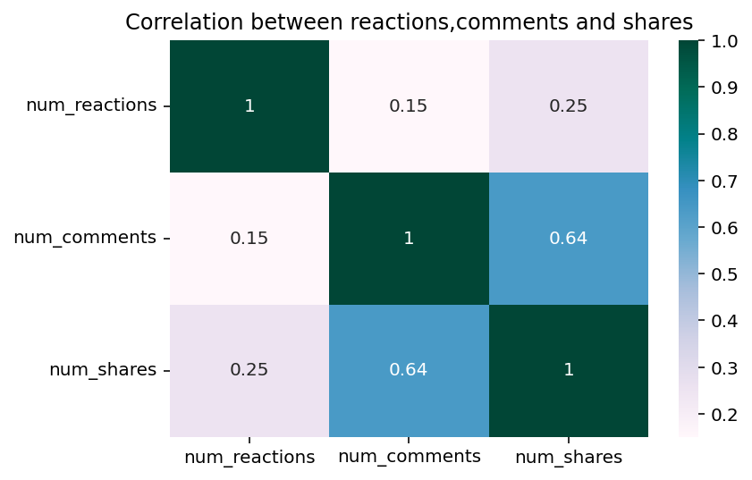
Co-relation between reactions , comments and shares
.
From the heatmap, you can see three main correlation values between num_reactions (reactions), num_comments (comments), num_shares (shares):
Reactions & Comments (0.15): Weak link; more reactions don't strongly predict comments.
Reactions & Shares (0.25): Weak-to-moderate link; slight tendency for posts with more reactions to be shared.
Comments & Shares (0.64): Strong link; highly commented posts are much more likely to be shared

Slide 7

Analysis of complete dataset
Dataset Overview: • Examined Facebook Marketplace posts with focus on engagement metrics (reactions, comments, shares, etc.)
Time-of-Upload Impact: • Analysis of post publish time (hour) shows varying engagement levels • Scatter plot indicates potential peak hours for higher reactions
Engagement Correlation: • Strong positive correlations found among reactions, comments, and shares • Highlights the interconnected nature of user interactions
Clustering Insights: • K-Means clustering (optimal clusters = 4) segments posts based on engagement metrics • Reveals distinct groups that may inform targeted content strategies
Post Type Analysis: • Encoded post types (e.g., 0, 1, 2, 3 corresponding to categories like 'link', 'photo', etc.) • Distribution and average metrics per type help understand content performance

Slide 8

Conclusion
Optimal Posting Times: • Analysis indicates specific hours with higher engagement.
Engagement Synergy: • Strong correlations among reactions, comments, and shares suggest that boosting one metric may influence the others.
Audience Segmentation: • Clustering into 4 distinct groups provides insights for targeted content strategies.
Content Strategy: • Variations in performance across post types highlight the need for tailored approaches.

